Slide 1
GENERATIONS
OF COMPUTERS
1 VACUUM TUBES
2 TRANSISTORS
From huge machines to smart devices
3 ICs
4 MICROPROCESSORS
5 AI
LOOK • TALK • THINK • COMPARE

Slide 2
Before we start…
What does “generation” mean?
1. Technology changed
2. Computers improved
3. Ask yourself
A new generation used newer technology.
They became smaller, faster and easier to use.
What changed from one generation to the next?
QUICK QUESTION
If a computer became smaller AND faster, is that an improvement?
Raise your hand: YES or NO

Slide 3
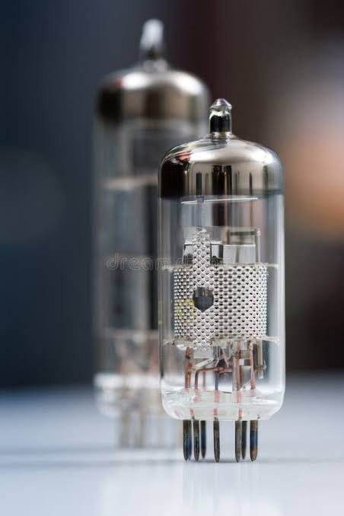
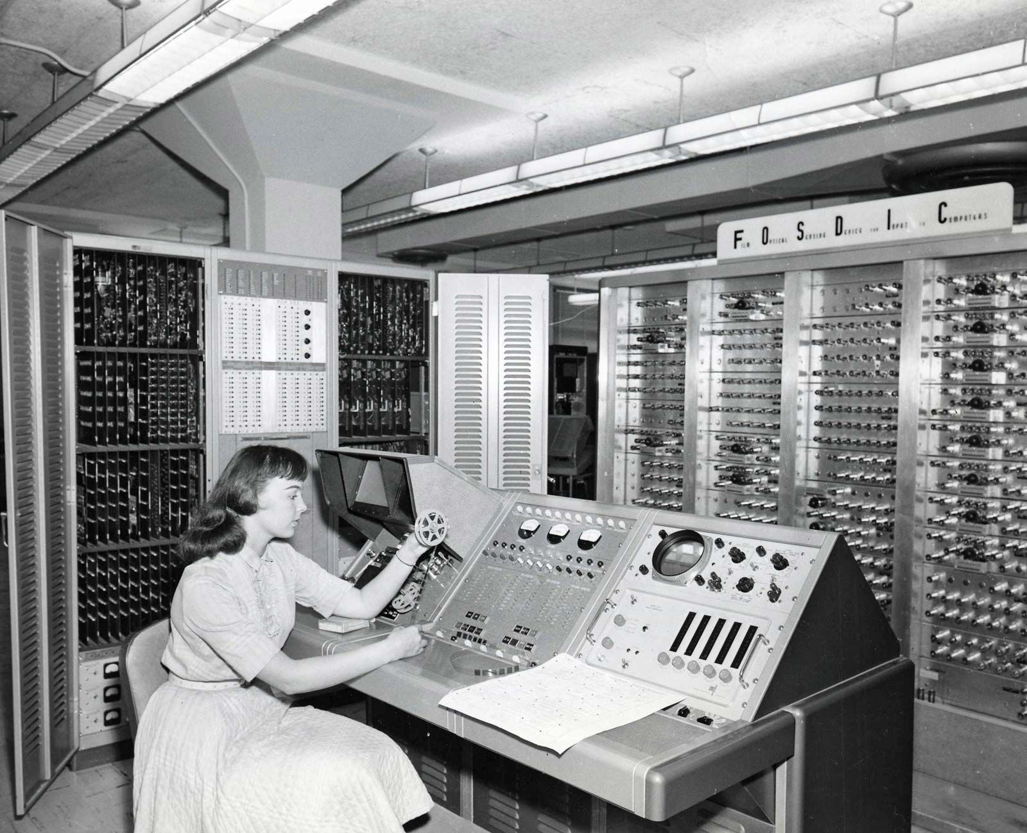
GENERATION 1
1940s–1958
LOOK AT THE PHOTOS
TECHNOLOGY USED
Vacuum tubes
3 EASY CHARACTERISTICS
• Very large
• Used a lot of electricity
• Produced a lot of heat and often broke down
TECHNOLOGY
EXAMPLE: ENIAC
USES
• Large mathematical calculations
• Scientific work
• Military calculations
Which photo shows the technology?
Vacuum tubes
Example: ENIAC

Slide 4
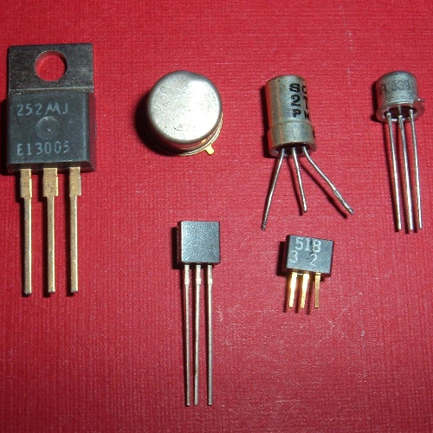
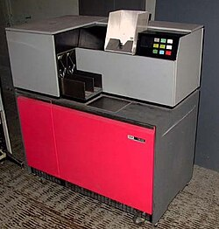
GENERATION 2
1958–1964
LOOK AT THE PHOTOS
TECHNOLOGY USED
Transistors
3 EASY CHARACTERISTICS
• Smaller than vacuum-tube computers
• Faster
• Produced less heat and were more reliable
TECHNOLOGY
USES
• Science
• Business work
• Early computer games
What changed from Generation 1?
Turn to a friend and give one answer.
Transistors
Example: IBM 1400

Slide 5
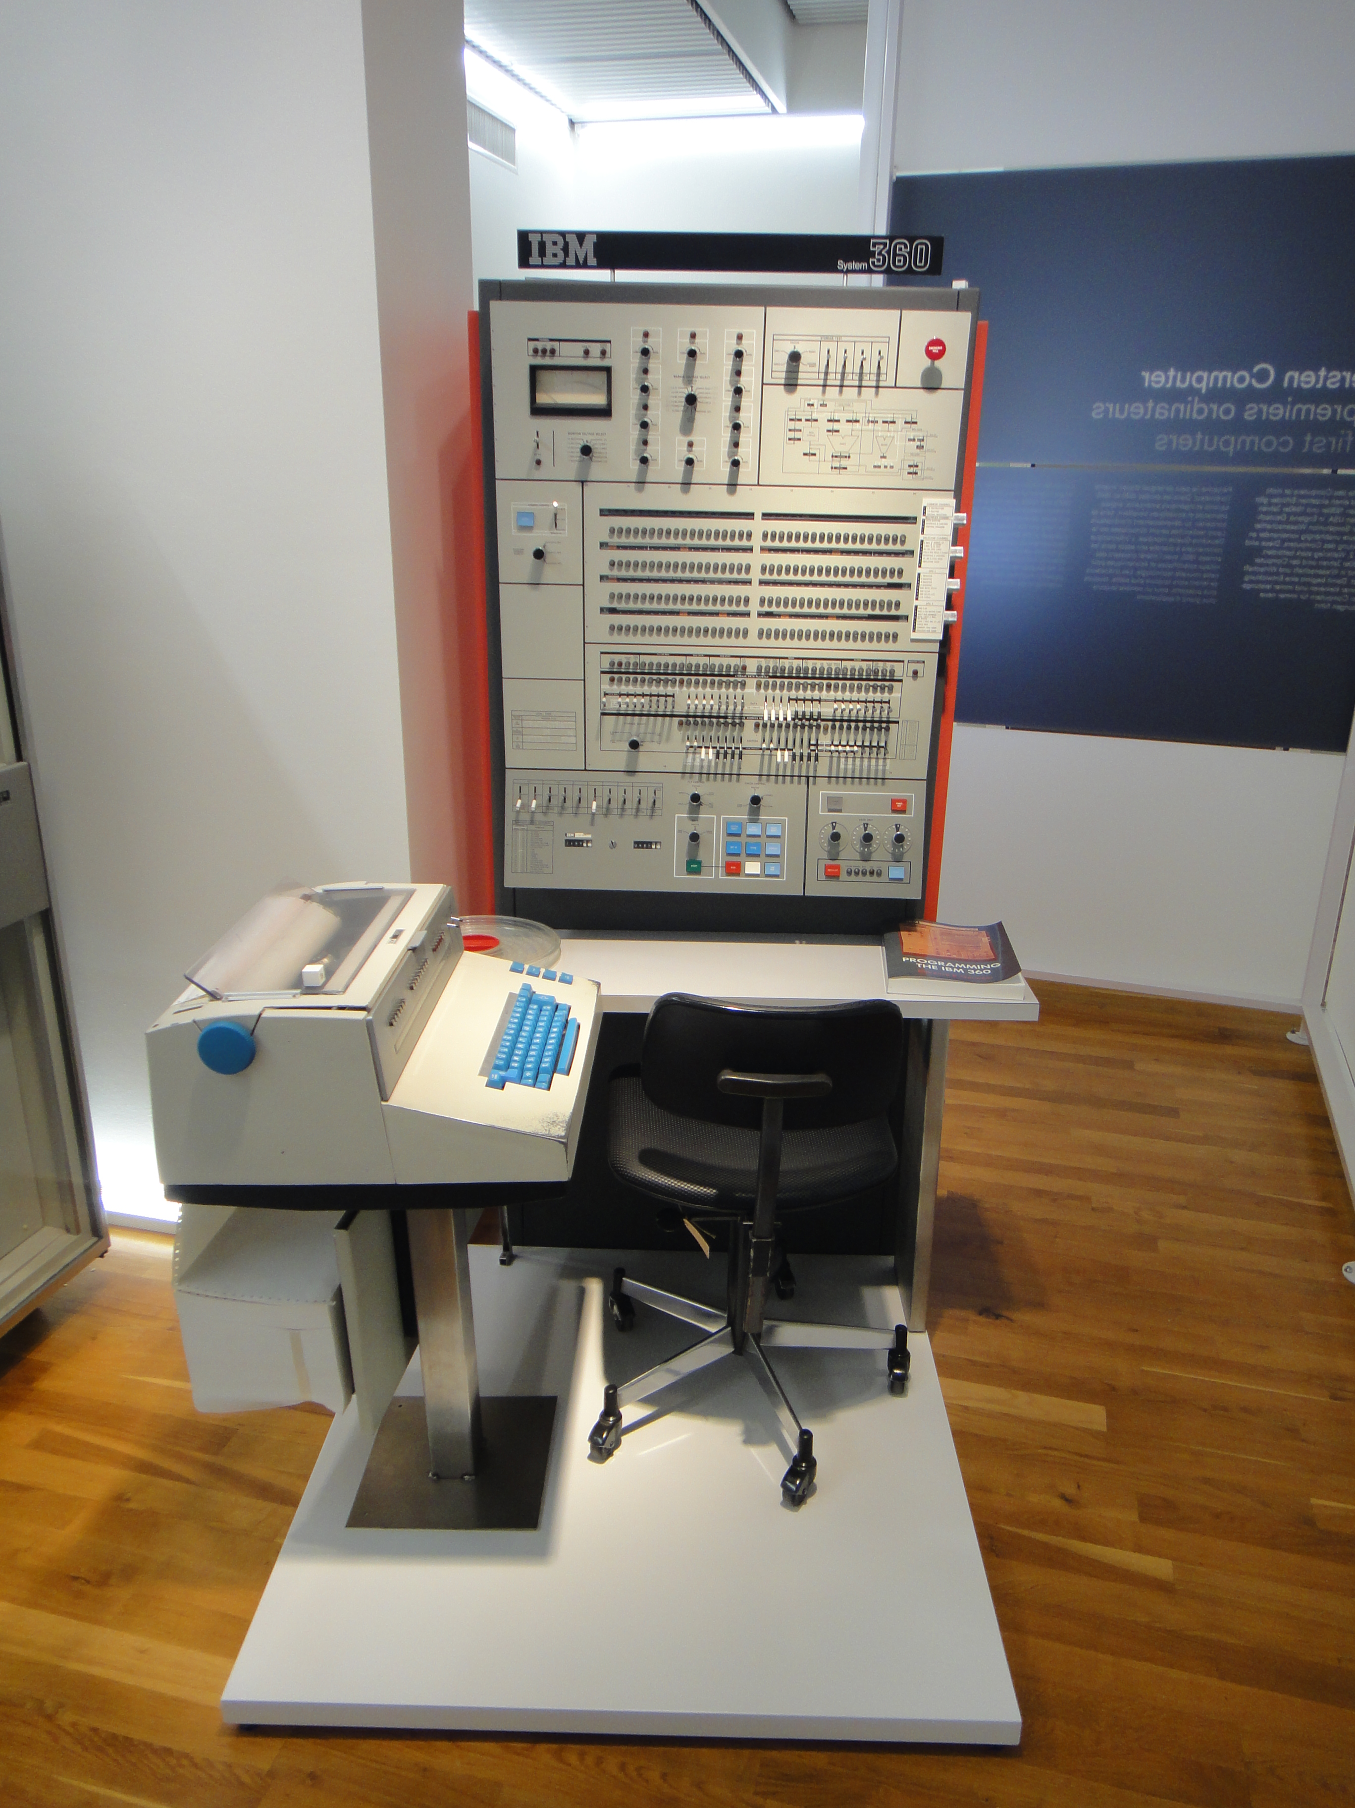
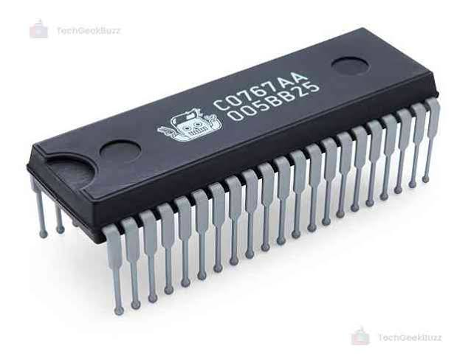
GENERATION 3
1964–1970
LOOK AT THE PHOTOS
TECHNOLOGY USED
Integrated circuits (ICs)
3 EASY CHARACTERISTICS
• Many tiny circuits on one chip
• Smaller than before
• Easier to program and maintain
EXAMPLE: IBM SYSTEM/360
USES
• Word processing
• Calculations
• Business applications
Turn to a friend and give one answer.
Intergrated circuits
Example: IBM System 360

Slide 6
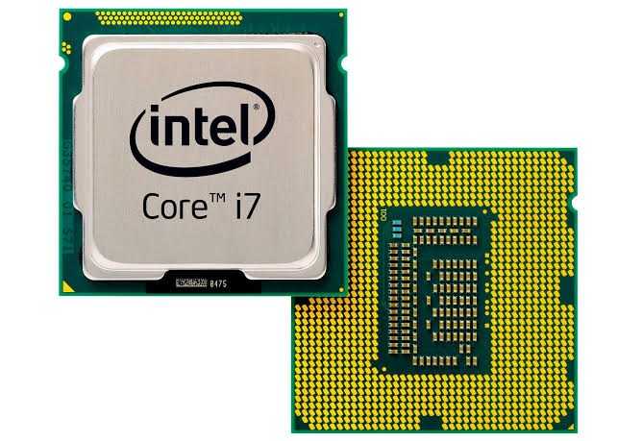
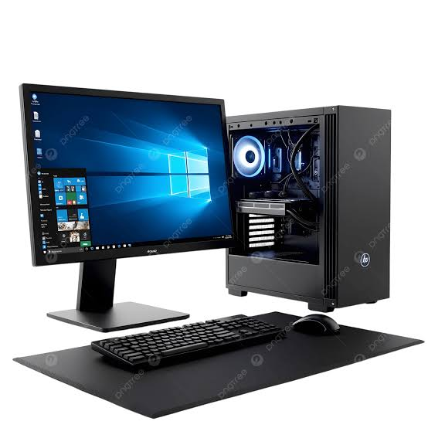
GENERATION 4
1970–present
LOOK AT THE PHOTOS
TECHNOLOGY USED
Microprocessors
3 EASY CHARACTERISTICS
• Very small electronic circuits
• Computers became much smaller
• Low heat and easier to use
EXAMPLE: ALTAIR 8800
USES
• Personal computers
• Business and financial work
• Networks and the Internet
What devices around you have a processor?
TECHNOLOGY
Turn to a friend and give one answer.
Microprocessor
Modern Computer

Slide 7
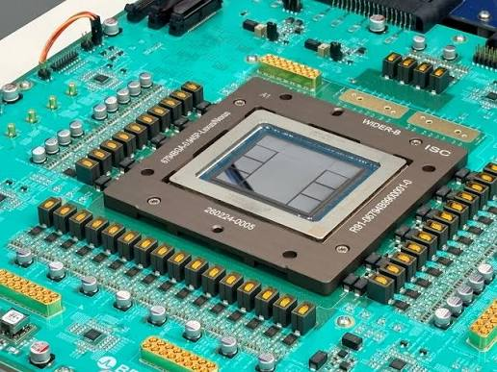
GENERATION 5
Today / modern computers
LOOK AT THE PHOTOS
TECHNOLOGY USED
Artificial intelligence (AI) + powerful processors
3 EASY CHARACTERISTICS
• Very fast and powerful
• Can use artificial intelligence
• Small devices can do many tasks
EXAMPLE: MODERN LAPTOP
USES
• Learning and communication
• Internet and entertainment
• Helping people make decisions
AI Chips/Advanced Computing
Modern Computers

Slide 8
Let’s compare!
What happened as computers changed?
Generation
Main technology
What changed?
1st
Vacuum tubes
Very large • Hot • Slow
2nd
Transistors
Smaller • Faster • More reliable
3rd
Integrated circuits
Smaller • Easier to use • More capable
4th
Microprocessors
Much smaller • Personal computers • Networks
5th
AI + powerful processors
Very fast • Smart features • Connected
THINK: Which generation is the computer you are using today?

Slide 9
CLASS CHALLENGE
Match the technology to the generation
VACUUM TUBES
1st
FINAL QUESTION
Why do you think computers became smaller over time?
TRANSISTORS
2nd
INTEGRATED CIRCUITS
3rd
MICROPROCESSORS
4th
Discuss with your group.
AI
5th

Slide 10
PHOTO SOURCES
Real photographs used in the generation slides
1. ENIAC vacuum tubes + ENIAC — Wikimedia Commons (public-domain ENIAC photo; CC BY 2.0 tube photo)
2. Transistor + IBM 1401 — Wikimedia Commons (CC BY 2.0 transistor photo; public-domain IBM 1401 photo)
3. Integrated circuit + IBM System/360 — Wikimedia Commons
4. Intel 4004 microprocessor + Altair 8800 — Wikimedia Commons
5. Hailo AI Accelerator + modern laptop — Wikimedia Commons
The deck content follows the attached teaching material.
Image pages/credits are linked in the photo captions/source list.

